Slide 1
Oem/odm feedback on cg questionnaire
Prepared by: Jagadeesh Radhakrishnan, Harry Yu, Shuh An Moy
Corner Glue WG, WW33’17

Slide 2
Survey overview
NB MSS – Notebook Market Segment Share
Feedback is based on discussion with following OEM/ODM teams
Lenovo, HP, Dell, Asus (top 4 cover 60% NB MSS), Acer, Microsoft, Samsung
Quanta, Wistron, Compal (top 3 cover 65-70% NB MSS), Inventec, Pegatron
Mobile industry have had bad experience of corner SJ crack previously (Brookdale Chipset)
CG was recommended to help prevent SJ crack and increase SJ reliability and most customers continue to use, generation after generation
MSFT is the only exception we know so far – that performs reliability test w/ and w/o CG and decide.
Top DT customers (Gigabyte and MSI) seldom add CG on Intel PCH (One exception: Asus)

Slide 3
Survey Questions (1 of 2)
1 | What is driving the requirement to use Corner Glue? (OEM Requirement, Reliability, Perception, etc) | It is a combination: some OEMs require adding glue to big BGAs, eg., Acer, Asus, Lenovo (corner fill or full underfill). Some ODMs proactively add CG to BGAs. | Who chooses corner glue, OEMs or ODMs. Wondering who would need to be influenced if a glue is found to not meet requirements.
2 | UV Cure vs Thermal Cure: Is there any restriction / preference on using UV cure vs thermal cure? If so, why is one preferred vs the other? | Both UV glue and thermal glue are widely used. Factory space is one of the main reason (UV cure uses less space than thermal cure). Another reason, per customer saying, UV is easier to rework. Material cost is another consideration. | Helps to narrow Intel's evaluation options. We will focus on the type that most ODMs use.
The CG information we got from our last CNL Mfg. Intro trip:
  Loctite 3619 (Thermal); Loctite 3609 (Thermal);
  EICT (UV); U-BOND; Model:UB-4305 (UV); Loctite 3705 (UV); ASEC-AS3910 (cornerfill); 視域:UV649/信友:3329/DYMAX 9-20558 (UV); ZhongYu Model:ZY-303 (UV cure)
  Panasonic ADE480D-1 (Pre-SMT);

Slide 4
Survey Questions (2 of 2)
3 | Cure temperature: What is the max temperature allowed for thermal cure? | Follow vendor's recommendation | Some glues allow for faster cure at higher temps. We want to align with their processing parameters
4 | Cure time: What is max time allowed for cure? | Follow vendor's recommendation | We want to align with their processing parameters and reduce our options of glues to test
5 | Reworkability: Do you require reworkable corner glue? | Yes. Currently, LCFC’s feedback is that cornerfill/underfill is very hard to rework, but it is Lenovo’s request. | If reworkability is required, Intel will only focus on reworkable glues for to evaluate
6 | Describe the dispense pattern of the CG material. (Single Dot / Multiple Dots / Edges / Corners) | Most customer use L-shape at corner Wistron use multiple dots (pre SMT) at corner Samsung using Underfilm (pre SMT) at corner | Need to align our testing to ODM preferences for dispense pattern
7 | When is corner glue applied? (Before SMT Reflow, After SMT Reflow, After ICT, After Functional Test, etc) | Almost all customer apply it after reflow, before test. Wistron and Samsung apply pre SMT For Lenovo (and it's ODM), they apply corner fill and underfill after test, because underfill is hard to rework | Would like to know if the glue is cured in the SMT reflow oven, a separate glue oven, etc. This is a clarification of the question that was asked in the last survey
8 | How long is required to qualify a new corner glue for use on products? | We don't have the information, based on SJQ solder paste qualification experience, we think 1 year is required. | If a new glue is needed, how much notification should Intel provide?

Slide 5
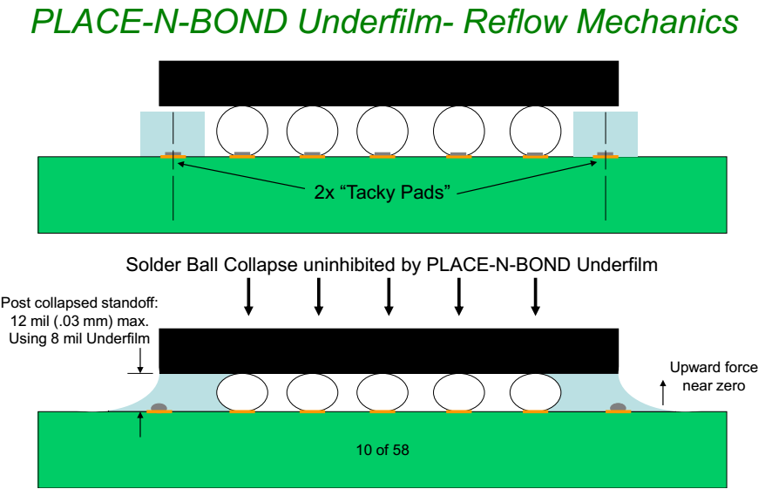
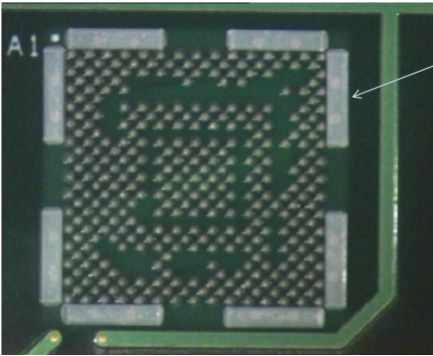
Pre-SMT Underfilm
<material included just to show concept>
Samsung uses similar concept in SKL platform but has not revealed their material choices

Slide 6
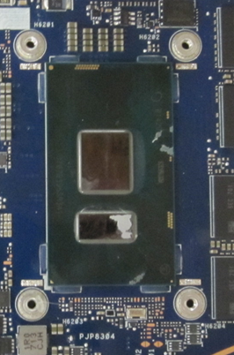
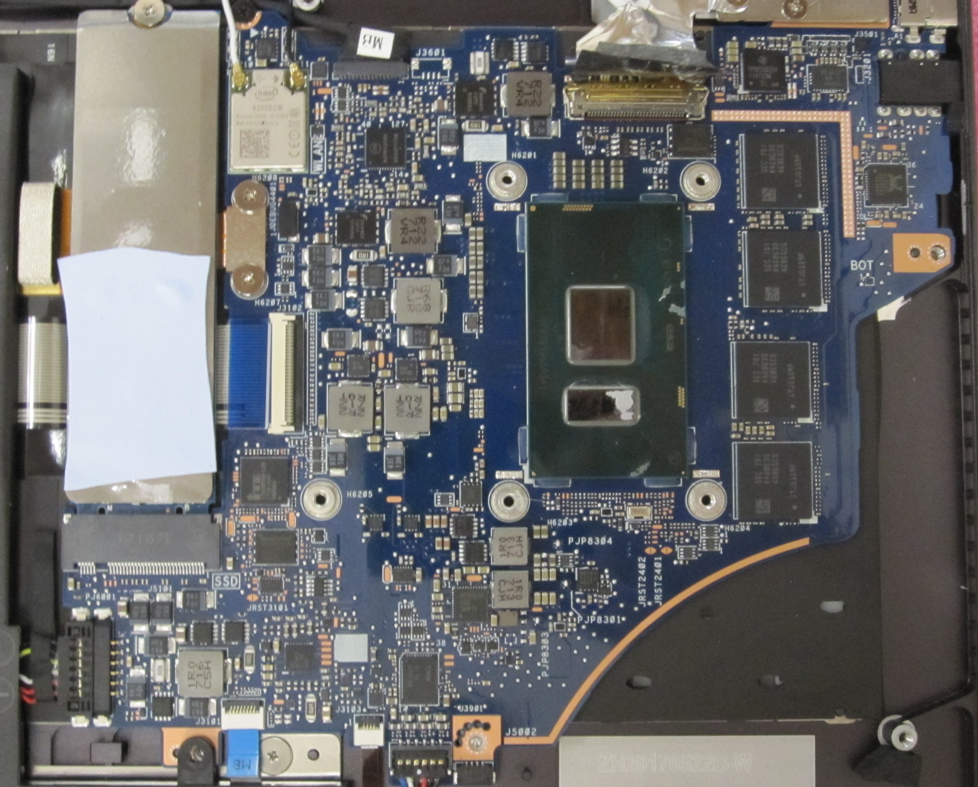
A variation of L-shape Corner Glue
(Seen in Asus/UX370/KBL-U)
Heatsink mount holes closer to package is driving a variation of L-shape corner glue

Slide 7
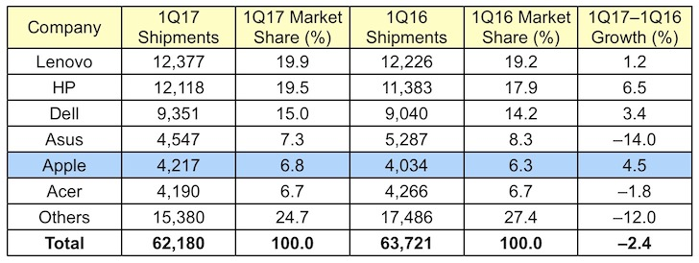
Top OEM Market Segment

Slide 8
Cannon Lake Mfg. Intro Tour – CG Information (April’17)

